Slide 1
What is the cloud?
Konrad Karczewski
Makerere GINGER training
November 15, 2021

Slide 2
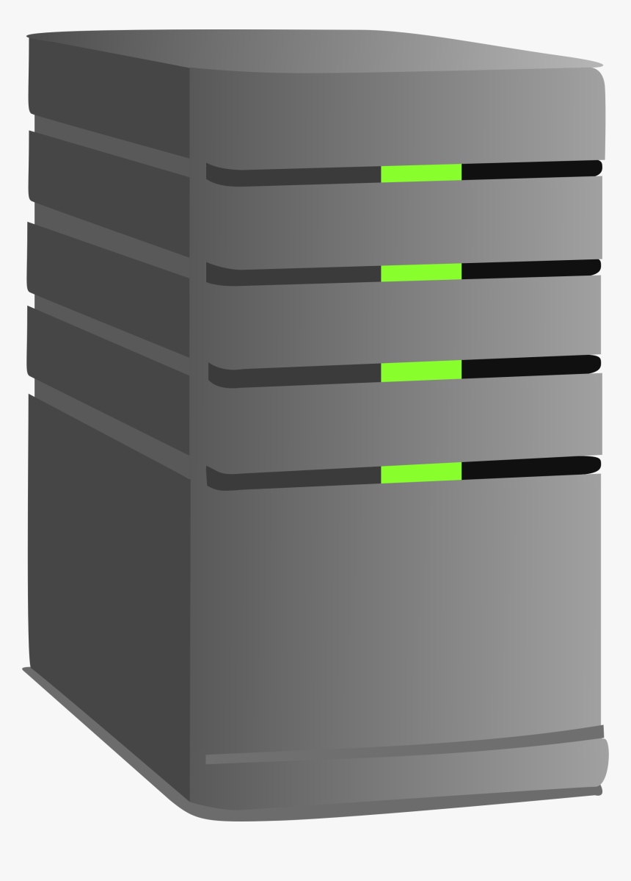
Broad definition
Cloud computing: storing and accessing data and programs over the Internet instead of your computer’s hard drive
Why is it “the cloud”?: A metaphor for the internet
Goes back to presentations showing connections going in and out of a cloud
Local machine
Server
Cloud (remote servers)

Slide 3
Modern definition
Internet-based computing services
Remotely hosted: data and compute are hosted on remote infrastructure
Commodified: pay-as-you-go, like other utilities (e.g. electricity)
Common acronyms: *aaS (as a service)
IaaS: Infrastructure-as-a-service
Rent a “computer” by the hour
SaaS: Software-as-a-service
Fully abstracted out (e.g. Gmail, Google Drive, Dropbox)

Slide 4
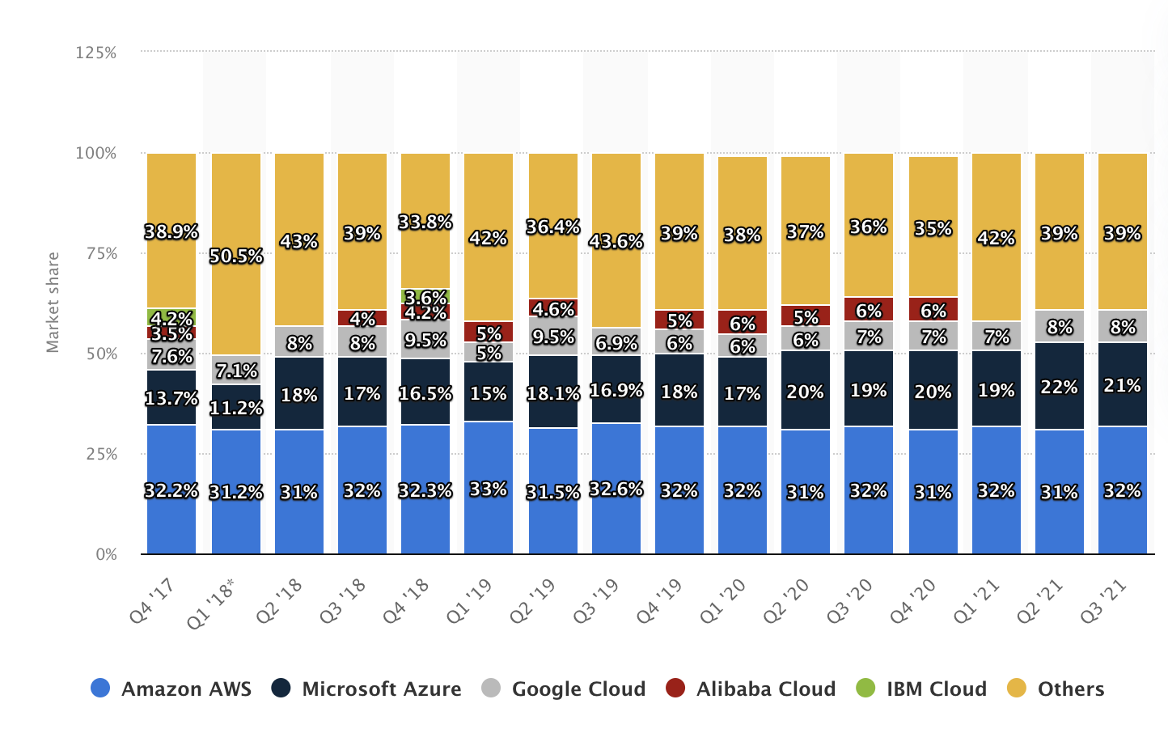
Cloud providers
3 major providers
Amazon
Microsoft
Google
Most offer the same set of products with slightly different configurations, pros/cons

Slide 5
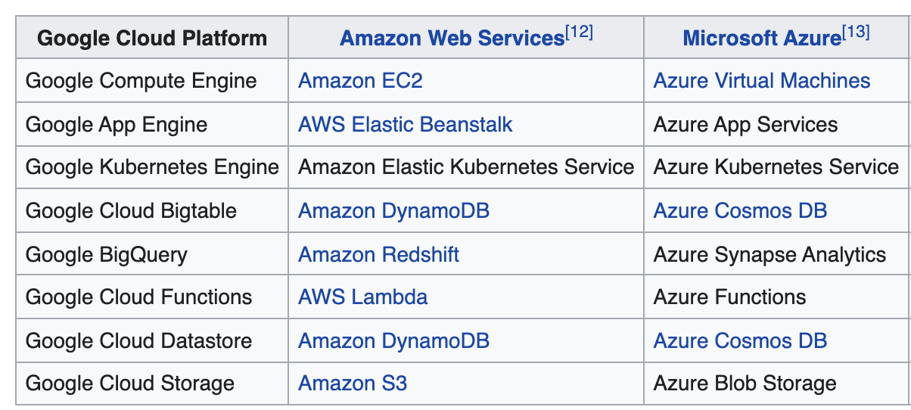
Google Cloud Platform (GCP)
Hundreds of products (it can be overwhelming!)
All of these are “the cloud” – you may talk to someone about the cloud and they may be referring to an entirely different ecosystem
Most fundamental ones (most “infrastructure”-like)
Google Compute Engine
Google Cloud Storage

Slide 6
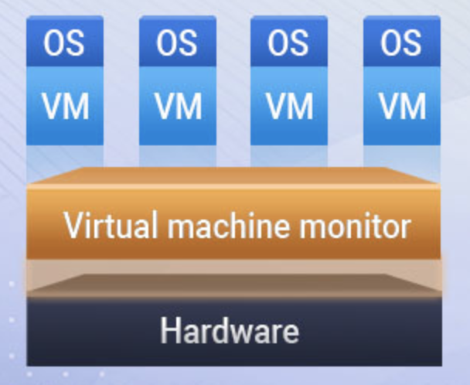
Google Compute Engine
Virtual machines
To the user, these are basically computers
They have some CPU, some memory, some disk space, and an operating system (OS)
When you rent a VM from Google, they apportion your requested resources from a larger Hardware pool
When you delete your VM, they go back into the pool

Slide 7
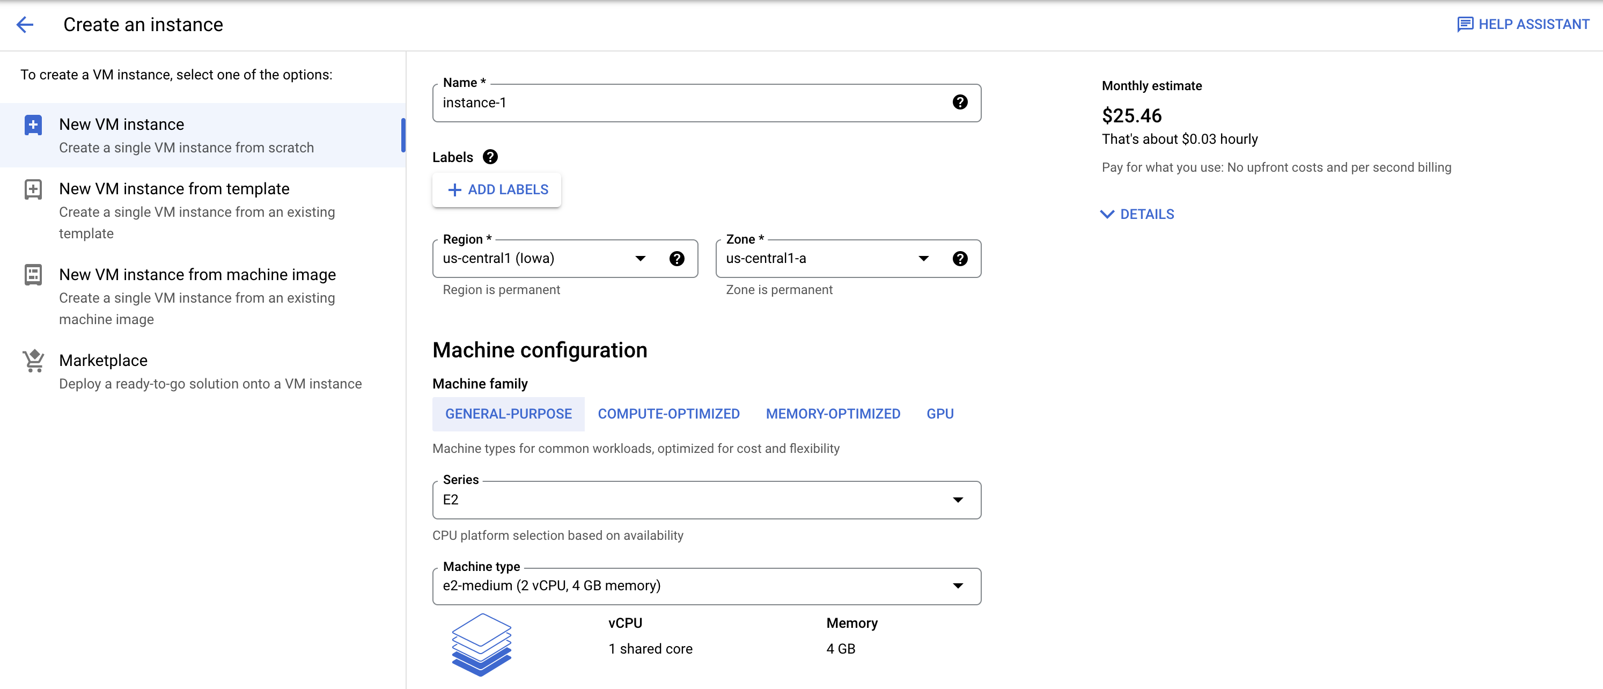
Google Compute Engine, in practice
Fully customizable (number of CPUs, memory, disk space)
Rule of thumb: a CPU costs about $0.04 or $1 per day
There is a way to get this down to $0.01/hour (pre-emptible)
Pricing: https://gcpinstances.doit-intl.com/

Slide 8
Google Cloud Storage
Files are stored on a distributed system (”object store”) rather than a traditional file system
Different storage types
Multi-regional (accessible quickly in multiple regions)
Regional (normal)
Nearline, Coldline, Archive: cheaper per month, but costs $ to access

Slide 9
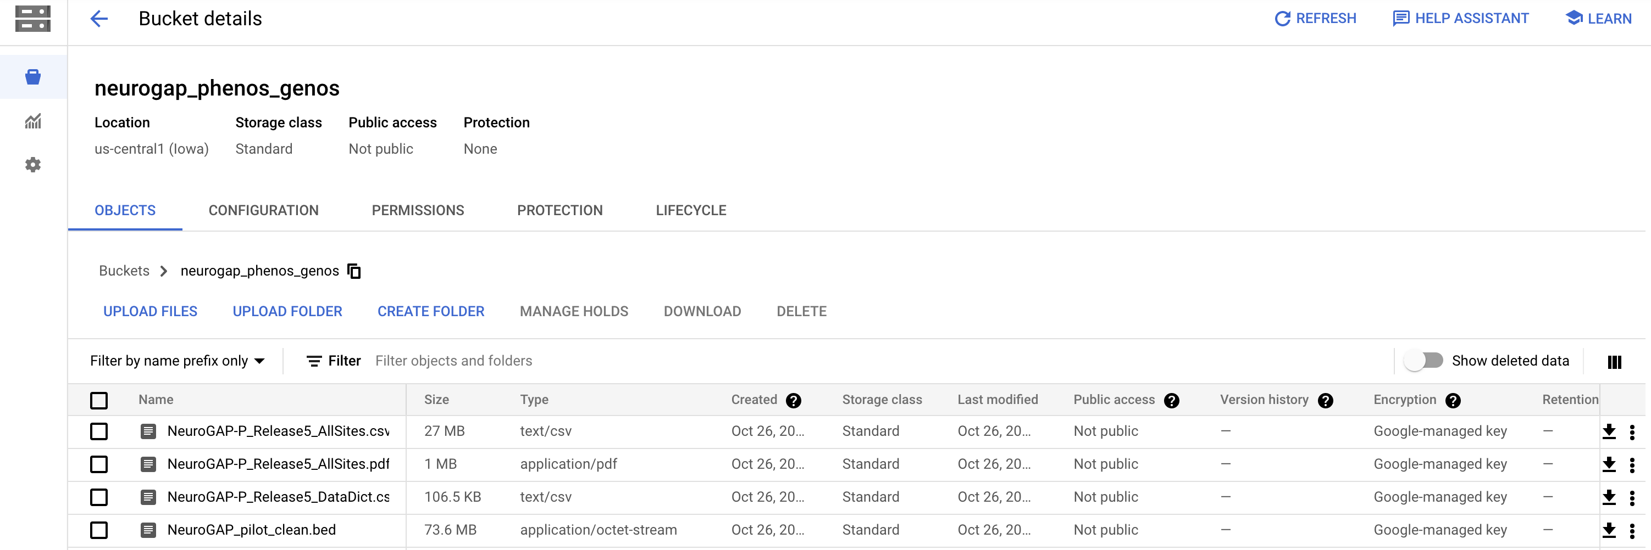
Google Cloud Storage, in practice
Bucket list:
Files within buckets:

Slide 10
Paying for the cloud
Compute engine: $0.04/CPU-hour
Very easy to rack up large bills
1,000 CPUs running for a week = $7,000
10 CPUs running for a year = $3,500
Storage: $0.02/Gb/month
Typically harder to rack up large bills at these prices, but still possible with huge datasets
$20/Tb/month

Slide 11
The cloud is awesome
Pay for the hardware you use
Be careful about spending! Stop/delete your VMs, and be careful of storage!
Scale analyses to thousands of machines
Easier reproducible and shareable workflows

